Slide 1
INSTRUCTIONS
Use the below given icons for building a visually appealing presentation
All the given icons are entirely editable, change their colour and play around.
Delete the ADDITIONAL RESOURCES slides before uploading the presentation
Delete the PLACE HOLDERS in the previous slides before updating your data
Delete the place holder images as well!
Use Poppins font only, If you do not have the font installed then go the link below, install the font and then re download this ppt and go on!
Submit PPT before the deadline.
Delete this slide before uploading
POPPINS FONT – CLICK HERE
HOW TO INSTALL FONTS – CLICK HERE

Slide 3
Add your team name here
Add one liner for the idea

Slide 4
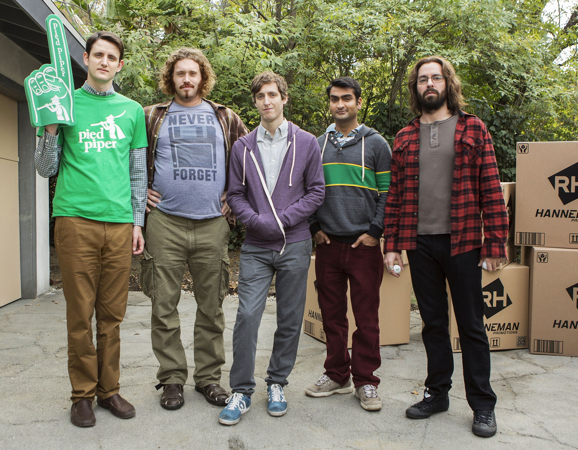
Team Skills & Roles
Instructions -
Briefly introduce your team.
Highlight the skills and expertise of your team members.
Explain how each team member contributes to the project.
(Name + Photo + Course + Expertise)
Be as cool as them (if you know)

Slide 5
Introduction
Instructions -
Explain your motivation for participating in the Sustainathon

Slide 6
Problem Statement
Instructions -
Describe the sustainability problem or challenge you aim to tackle.
Include relevant statistics or data to highlight the issue's significance.

Slide 7
Solution Overview
Instructions -
Present a high-level overview of your sustainable solution or idea.
Highlight the key features or components.
Explain how your solution addresses the identified problem.

Slide 8
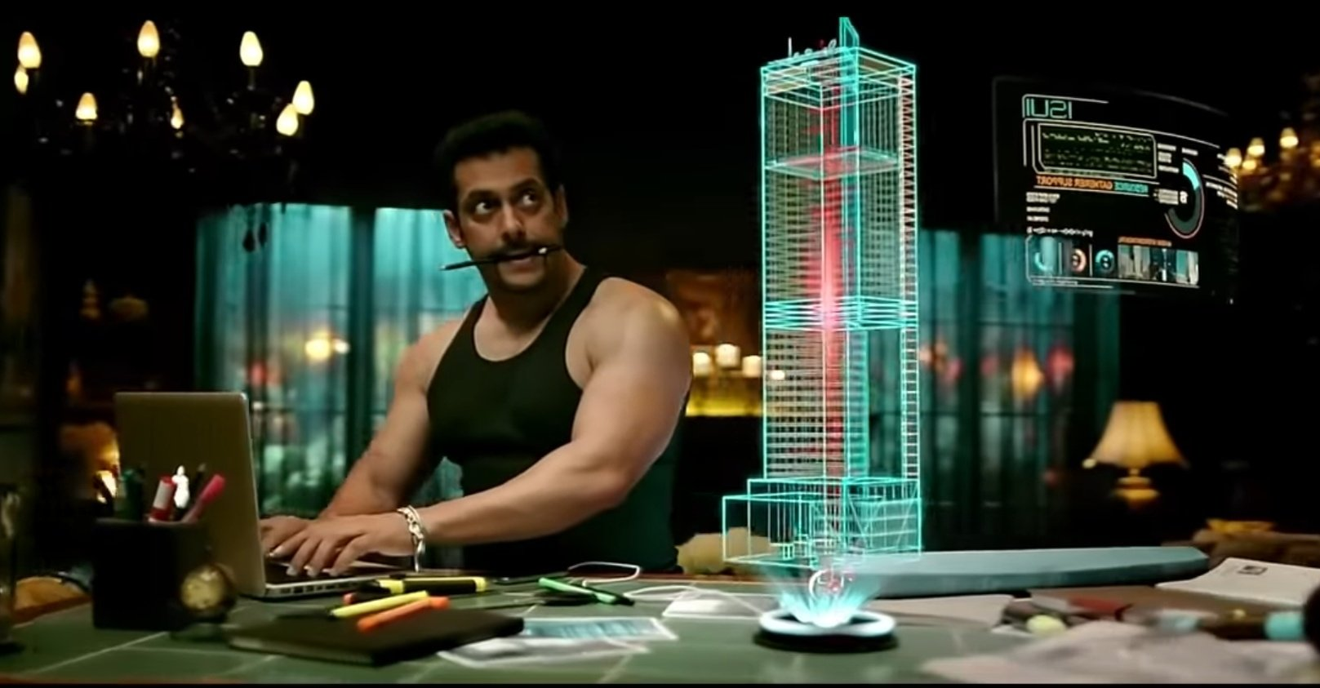
Technology Overview
Instructions -
Highlight the technology used.
Talk more about the efficiency of your technology solution.
Outline the technology stack or tools you plan to use.
Explain how these tools support your solution.
Talk about your tech

Slide 9
Target Audience
Instructions -
Specify the target audience or beneficiaries of your solution.
Explain why this audience is important and how they will benefit.

Slide 10
Market Research
Instructions -
Share any market research or analysis you've conducted.
Highlight competitors or existing solutions and how your idea is unique.

Slide 11
Implementation Plan
Instructions -
Provide a timeline or roadmap for developing and implementing your solution.
Include milestones and key deliverables.

Slide 12
Sustainability Impact
Instructions -
Explain the environmental, social, and economic benefits of your solution.
Quantify the potential positive impacts (e.g., carbon emissions reduced, lives improved).

Slide 13
Challenges & Risks
Instructions -
Identify potential challenges or risks associated with your project.
Explain how you plan to mitigate these challenges.

Slide 14
Budget & Resources
Instructions -
Provide an estimated budget for your project.
Mention any resources you need, such as funding, mentors, software, datasets, prototyping tools or partnerships.

Slide 15
Next Steps
Instructions -
Summarize the key takeaways from your presentation.
Explain what you need from the Sustainathon organizers or mentors to move forward.

Slide 16
Q&A
Instructions -
Mention any questions for the evaluators.

Slide 17
Contact Information
Instructions -
Reiterate your team's contact information for further inquiries.
Give correct contact info so we don’t reach out to Babu Bhaiya!

Slide 19
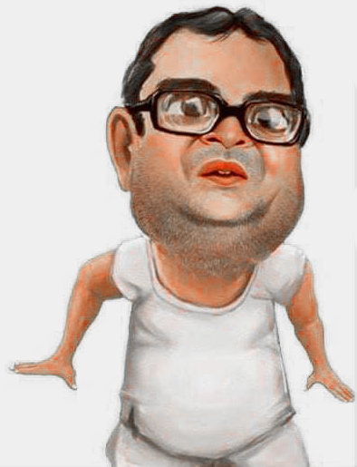
Additional Resources
DELETE KARDE RE BABA
MERE KO BHI AUR BAAKI SARE UNECESSORY SLIDES KO!!!

Slide 20
Delete this slide before uploading

Slide 21
Delete this slide before uploading
Text 1
Text 2
Text 3
“Mercury is closest planet to the Sun and the smallest”
“Despite being red, Mars is actually a very cold place”
Add the title here
2016
2017
2018
2019
2020
“Venus is the second planet from the Sun and is terribly hot”
“Neptune is the farthest-known planet from the Sun”
“Saturn is a gas giant and has several rings”
Text 4
Text 5
Text 6

Slide 22
Delete this slide before uploading

Slide 23
Delete this slide before uploading

Slide 24
Delete this slide before uploading

Slide 25
Delete this slide before uploading

Slide 26
Delete this slide before uploading

Slide 27
Delete this slide before uploading

